Slide 1
Network : Internet Operation
Jae Hyeon Kim

Slide 2
Reference
William Stalling, Data and Computer Communications 10/E, Prentice Hall

Slide 3
Internetwork Operation
Consider mechanisms for handling growth in network traffic
from low-volume text based terminal/email
to high volume multi-media web/voice/video
Historically, IP protocols gave best-effort datagram delivery to all services
Now, applications want variety of QoS (Quality Of Service) in IP networks
explore some new network services and functions

Slide 4
Multicasting
Multicast means the act of sending a packet from a source to a number of members of a multicast group
Has a number of practical applications
multimedia “broadcast”
teleconferencing
database
distributed computing
real time workgroups
Have design issues in addressing / routing

Slide 5
LAN Multicast
LAN multicast is easy
send to IEEE 802 multicast MAC address
since broadcast all stations will see packet, those in multicast group will accept it
only single copy of packet is needed
But it is getting to be harder in internetwork environment
IP includes addresses that refer to group of hosts on one or more networks =: multicast address
cf) IP address refers to an individual host on a particular network

Slide 6
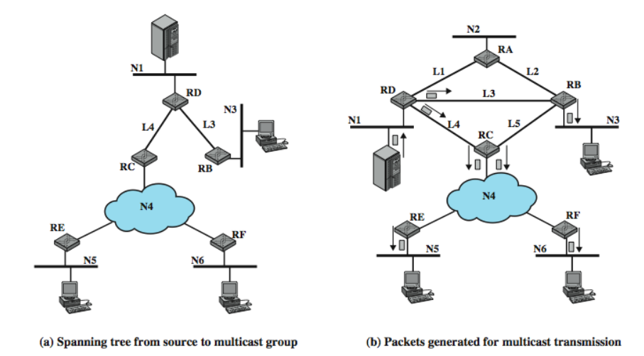
Multicast Example

Slide 7
Broadcast, Multiple Unicast, Multicast
Broadcast a copy of packet to each network
if server does not know members of group
requires 13 copies of packet
Multiple unicast
send packet only to networks that have hosts in group
11 packets
True multicast
transmit single packet along spanning tree
routers replicate packets at branch points of spanning tree
8 packets required

Slide 8
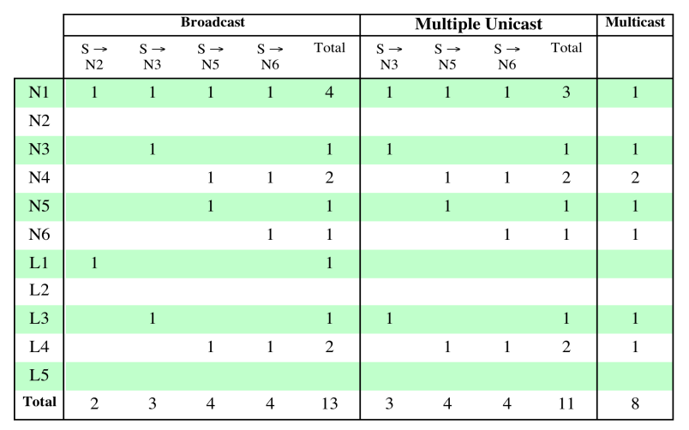
Traffic Generated by Various Multicasting Strategies

Slide 9
Requirements for Multicasting
Router have to forward more than one copy of packet
Need convention to identify multicast addresses (IPv4 Class D or IPv6 prefix)
nodes/router translate between IP multicast addresses and list of networks containing group members
Required for hosts to join/leave multicast group
which networks include members of given group
sufficient info to work out shortest path to each network
Routing algorithm to calculate shortest path

Slide 10
Internet Group Management Protocol (1)
RFC 3376 (IGMP v3) to exchange multicast group information between hosts & routers on a LAN
hosts send messages to routers to subscribe to and unsubscribe from multicast group
routers check which multicast groups of interest to which hosts
IGMP operation : join
IGMP host wants to make itself known as group member to other hosts and routers on LAN
to join, the host send IGMP membership report message
sent in IP datagram with the multicast destination address
the group member routers receive & learn new member

Slide 11
Internet Group Management Protocol (2)
IGMP operation : keeping list valid
routers periodically issue IGMP general query message
in datagram with all-hosts multicast address
hosts respond with report message
router needs to know at least one group member still active
each host in group sets timer with random delay
if timer expires, host sends report message
IGMP operation : leave
host leaves group by sending leave group message to all routers static multicast address
router determines if it have any remaining group members using group-specific query message

Slide 12
Mobile IP
Enables computers to maintain Internet connectivity while moving from one Internet attachment point to another
Particularly suited for wireless connections
mobile implies:
a user is connected to one or more applications across the Internet
the user’s point of attachment changes dynamically
all connections are automatically maintained despite the change of attachment

Slide 13
Basic Capabilities of Mobile IP
Network discovery
used to identify prospective foreign agents, by means of beacon
then a care-of address is dynamically acquired for a temporary IP address of current network
New address registration
the care-of address must be registered to home agent in order to redirect datagram reached to home to the foreign agent
authenticated registration procedure is used
Datagram tunneling
forwards IP datagram from a home address to a care-of address

Slide 14
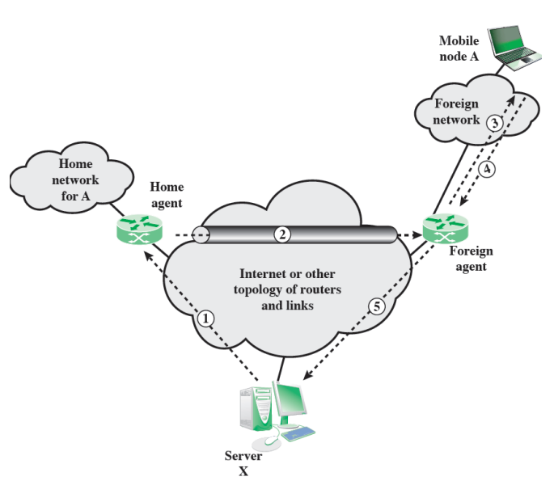
Mobile IP Scenario

Slide 15
Internetwork Quality of Service
Internet traffic continues to grow and change
demand for real-time responses
increasing use of audio, image, and video
heavy use of the World Wide Web
Packet-switching technology with routers functioning as switches was not designed to handle voice and video
strong need to support a variety of traffic with QoS requirements within TCP/IP

Slide 16
Internet Traffic Categories
Elastic traffic
can cope with wide changes in delay and/or throughput
traditional TCP/IP traffic
eg. FTP, email, telnet, SNMP, HTTP
Inelastic traffic
does not easily adapt to network variations, e.g. real time traffic
requirements : throughput, delay, jitter, packet loss
New Internet architecture requirements:
resource reservation protocol
elastic traffic still needs to be supported

Slide 17
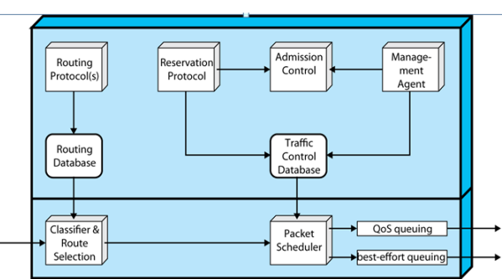
ISA Approach
Integrated Service Architecture (ISA)
intended to provide QoS transport over IP-based Internet
defined in RFC 1633
portions already being implemented in some routers
sharing capacity on congestion is the central design issue
To manage congestion and provide QoS, it makes use of:
admission control
routing algorithm
queuing discipline
discard policy

Slide 18
ISA Services
ISA service for a flow of packets is defined on two levels:
a number of general categories of service are provided, each of which provides a certain general type of service guarantees
guaranteed : service provides assured capacity
controlled load : tightly approximates the behavior visible to applications
best effort
within each category, the service for a particular flow is specified by the values of certain parameters
referred to as a traffic specification (TSpec)

Slide 19
Resource Reservation: RSVP
Resource ReSerVation Protocol : RFC 2205
provides supporting functionality for ISA
Applications reserves resources in-between routers to meet QoS
enables routers to decide ahead of time if they can meet the delivery requirement for a multicast transmission
Goals and characteristics
unicast and multicast
receiver-initiated reservation
maintaining soft state in the Internet
providing different reservation styles
transparent operation through non-RSVP routers

Slide 20
Receiver-Initiated Reservation
Since receivers specify the desired QoS, it makes sense for them to make resource reservations
different members of the same multicast group may have different resource requirements
QoS requirements may differ depending on the output equipment, processing power, and link speed of the receiver
routers can aggregate multicast resource reservations to take advantage of shared path segments

Slide 21
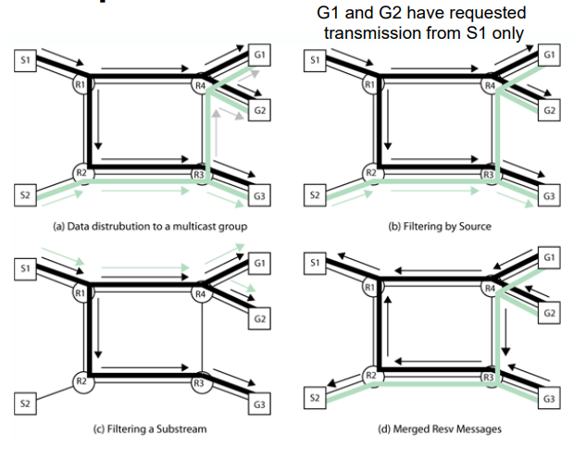
RSVP Operation

Slide 22
Differentiated Services (DS)
ISA and RSVP are relatively complex to deploy
Designed to provide simple, low overhead tool
specified in RFC 2475
IP packets labeled for differing QoS using existing IPv4 Type of Service or IPv6 DS field, so no change to IP is required
Key characteristics:
SLA(Service Level Agreement) is established prior to use of DS
DS is implemented in individual routers
most widely accepted QoS in enterprise networks

Slide 23
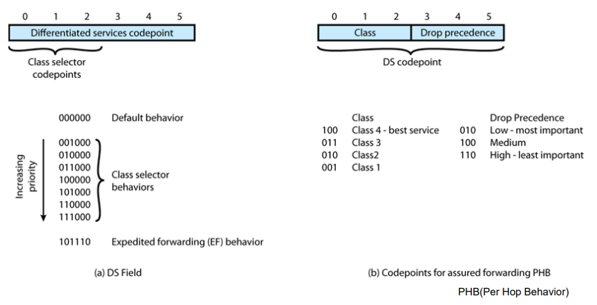
DS Field IPv6

